Slide 1
Active Supervision
Remote Work
Readiness
London Consulting Group
contact@londoncg.com

Slide 2
Agenda
Team Agreement
Remote Work Tools

Slide 3
Team Agreement
Remote Work Readiness

Slide 4





Building a strong Team Agreement
Technical Readiness
Have a connection of > 10 Mb/sec.
Use a headset and light the way to use your webcam.
Try connection and sound 5 minutes before videocalls.
Time Management
Stick to a routine and always start at the same time.
Manage time and energy. Focus on what is important.
Over communicate your work to your boss.
Business Readiness
Work on a chair not the couch or bed.
Be on time always. Punctuality matters.
Dress your best.
Attitude and Culture
Words Matter. Give Context, be clear on the Actions, and expected Results.
Run the extra mile. Assertive communication will be the challenge.
Technical Readiness
Time Management
The Four
Principles
Attitude and Culture
Business Prep

Slide 5
Remote Work Tools
Remote Work Readiness

Slide 6
















Choose the proper tools and integrate them
Project Management
Video Conferencing
E-mail
Google
Meet
Skype
Gmail
Communication Responsiveness
Docs and Knowledge Base
Instant Messaging
Outlook
Microsoft
Office Suite
Google
Hangouts
Decision Making

Slide 7


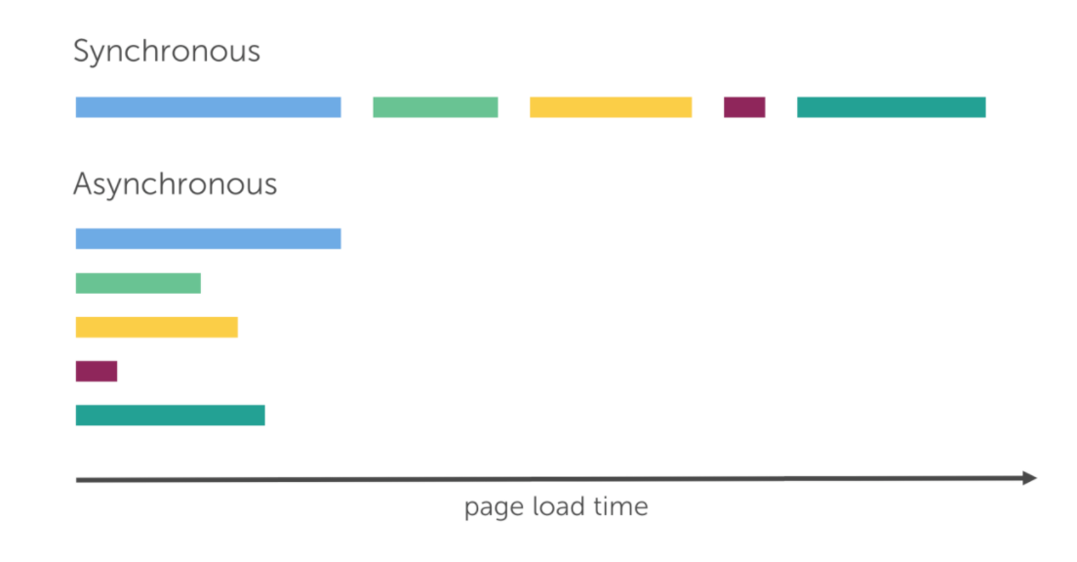

Final Considerations
Communicate in parallel (Async) not linear (Sync)
Give structure to you Knowledge Center
Consider that you will loose visibility of your team.
Be able to manage multiple tasks at different execution times.
Perform a 5’s initiative for your shared folders.
Structure and standardize the knowledge repository and make it collaborative.
Synchronous Communication and Management
Linear communication topic by topic.
Asynchronous Communication and Management
Parallel communication with different response times.
Structure &
Standardization
Digital 5’S
Permissions Management

Slide 8
Active Supervision
Remote Work
Readiness
London Consulting Group
contact@londoncg.com

